Slide 1
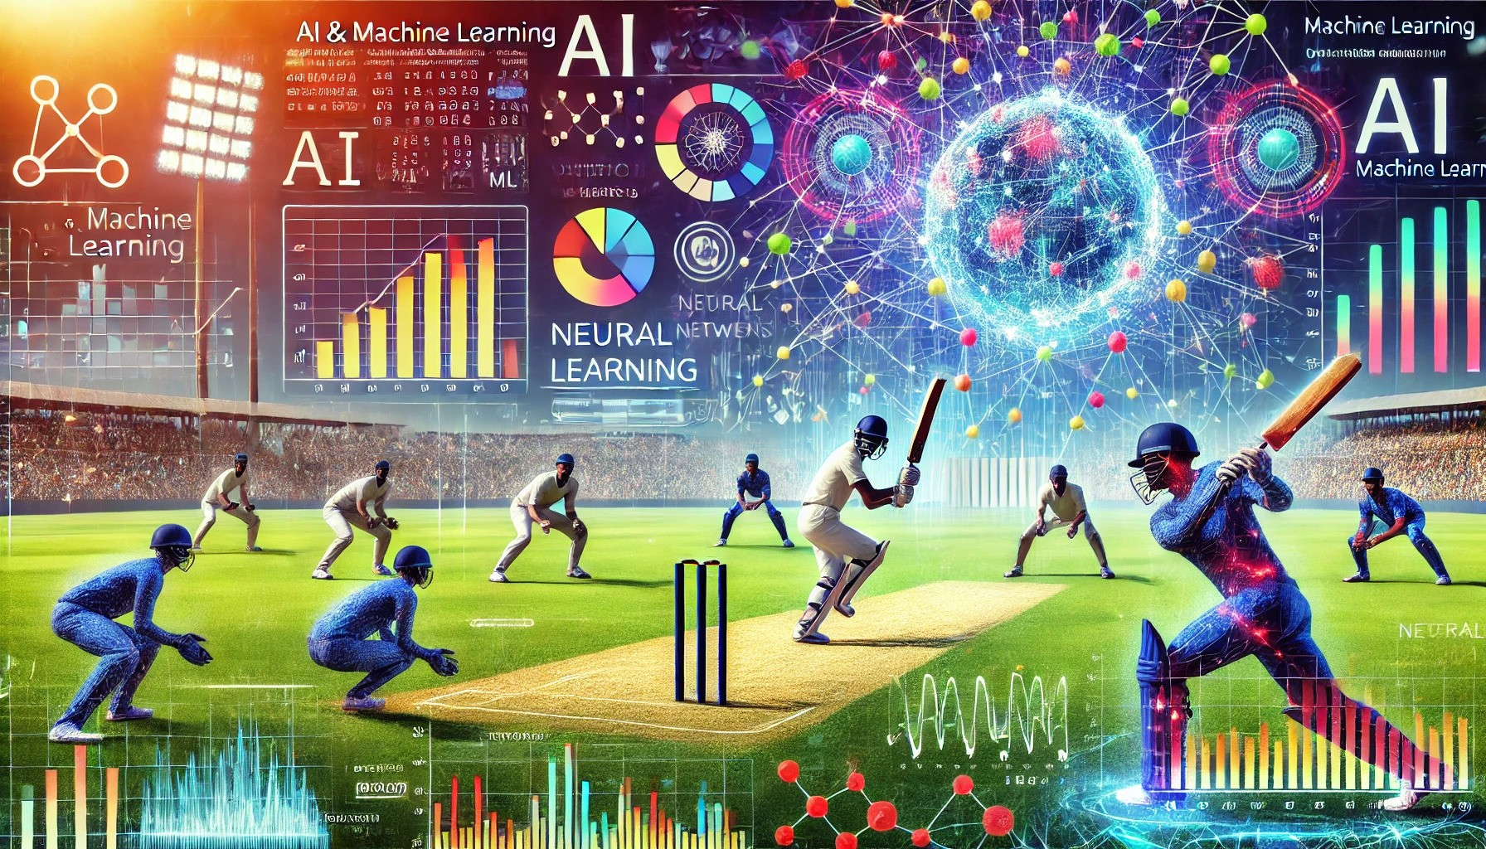
Cricket Insights: The Art of Prediction with AI and Machine Learning
By Ajinkya Thokal

Slide 2

Introduction
Cricket is a dynamic and intricate sport where variables like player performance, match circumstances, and tactical choices significantly impact the outcome. This study explores the use of advanced machine learning techniques to predict key aspects of cricket matches using historical data.

Slide 3
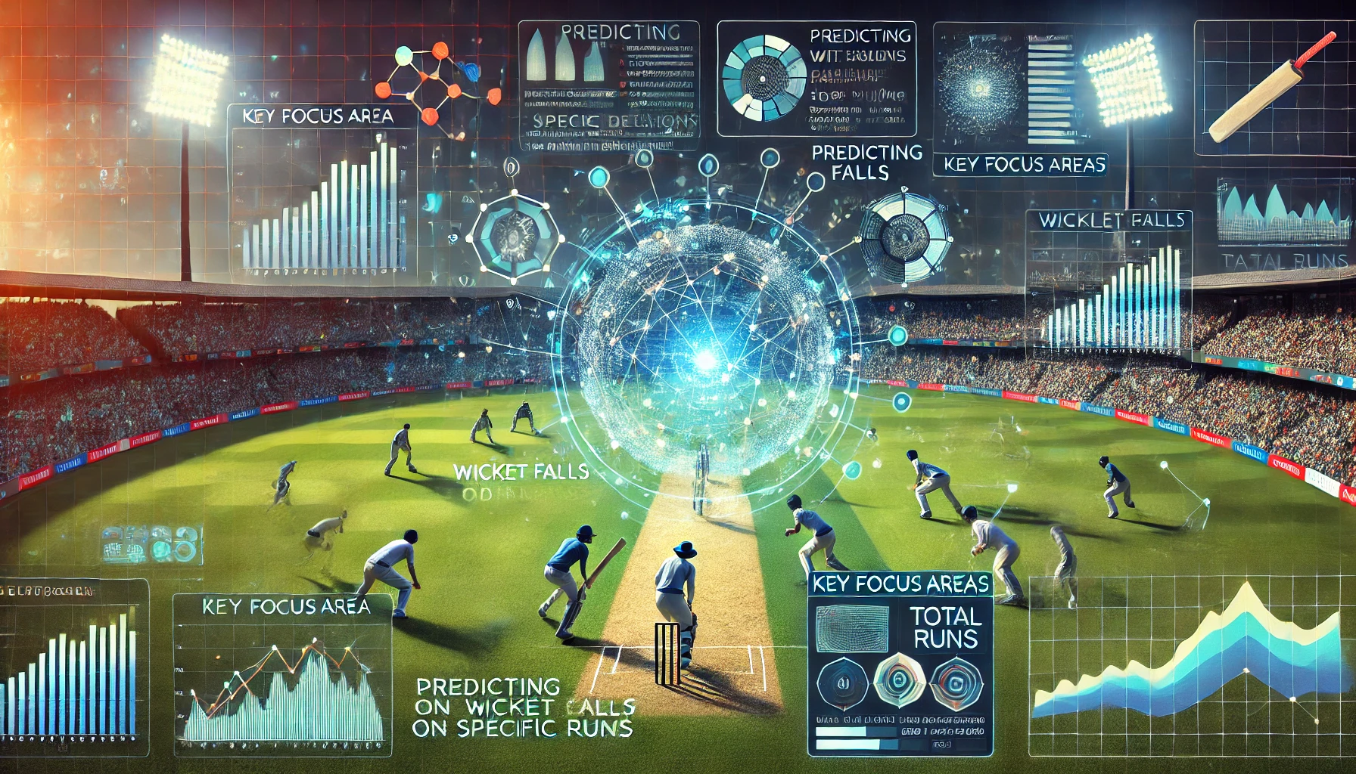
Objective
The objective of this study is to utilize sophisticated machine learning methods to forecast significant elements of cricket matches by using past data, focusing on predicting whether a wicket will fall on a particular delivery and the total number of runs scored in a match.

Slide 4
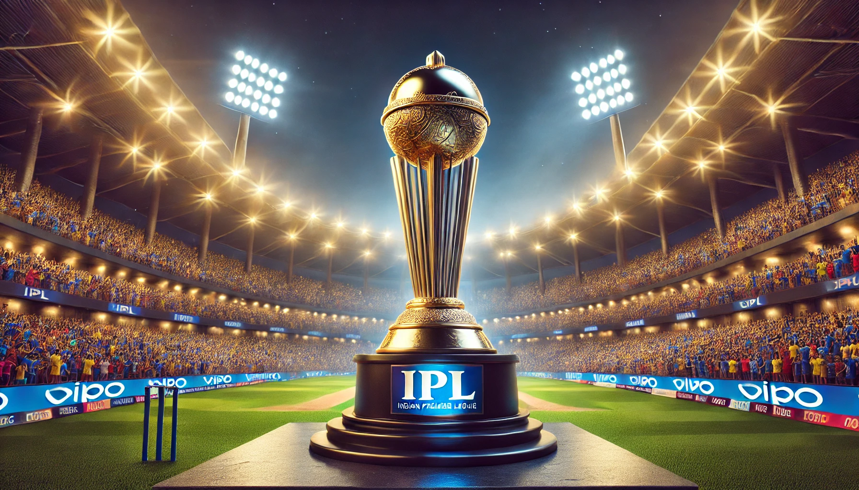
Datasets Used
This project uses historical IPL cricket matches data from two main sources: matches.csv and deliveries.csv. The matches.csv file contains details of each match, while the deliveries.csv file contains information at a delivery level.

Slide 5

Data Preparation
Several preprocessing steps were undertaken including feature engineering, merging datasets, data cleaning, and one-hot encoding of categorical variables.

Slide 6
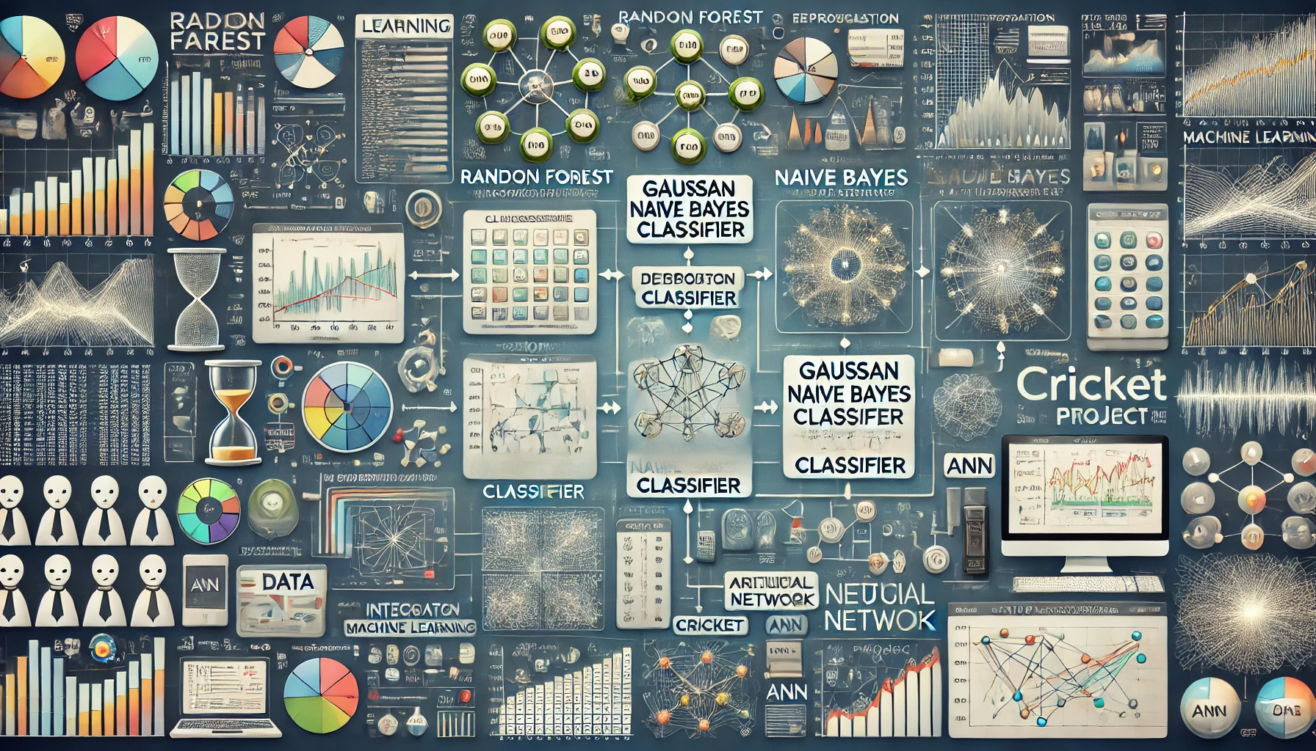
Machine Learning Models
1) Random Forest Classifier
2) Gaussian Naive Bayes Classifier
3) Artificial Neural Network (ANN).

Slide 7
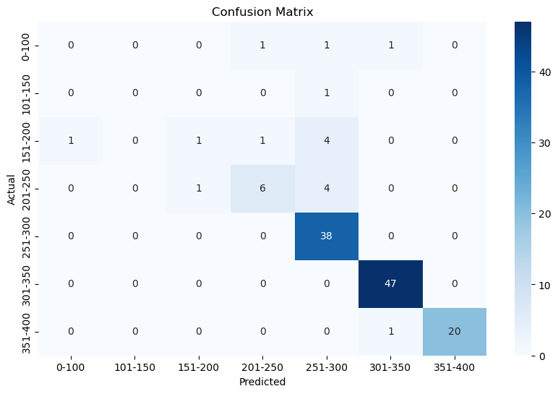
Random Forest Classifier
Random Forest is used for its ability to handle categorical data, robustness, feature importance, high performance, and scalability. It achieved an accuracy of 87.5%.

Slide 8
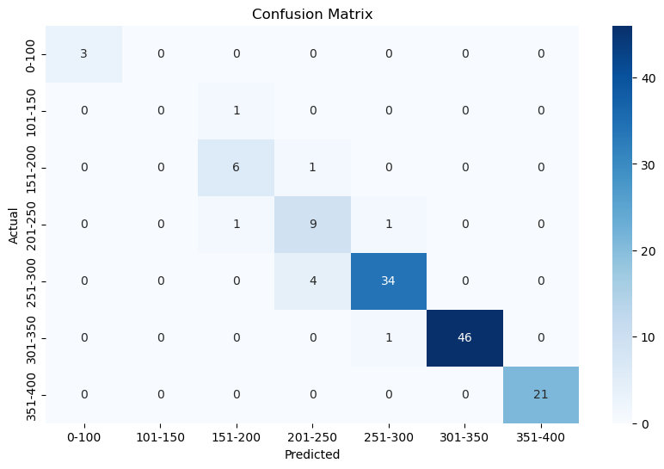
Naive Bayes Classifier
Naive Bayes is used for its efficiency with categorical data, computational efficiency, simplicity, and as a baseline comparison. It achieved an accuracy of 92.97%.

Slide 9
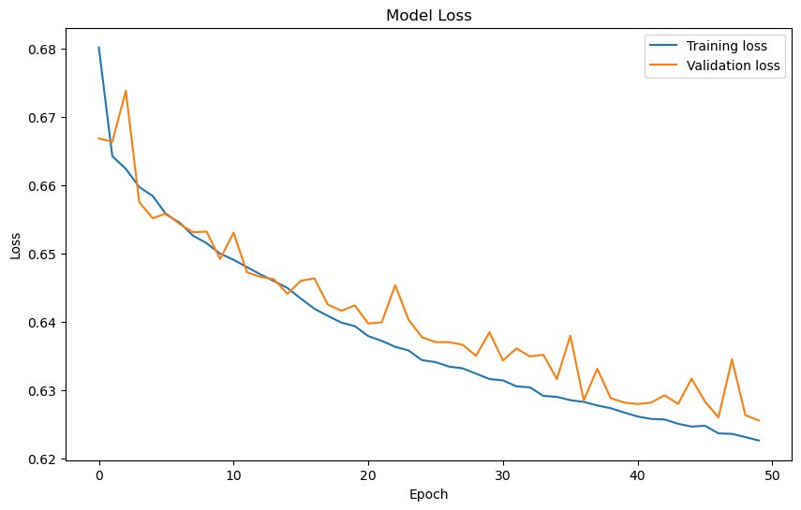
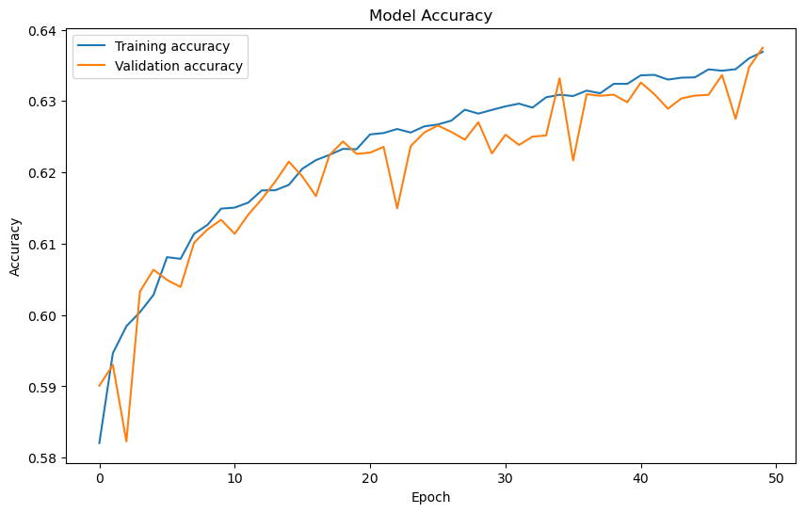
Artificial Neural Network
ANNs are used for their ability to capture complex, non-linear relationships. The model was trained for 50 epochs and achieved an accuracy of 63.4%.

Slide 10
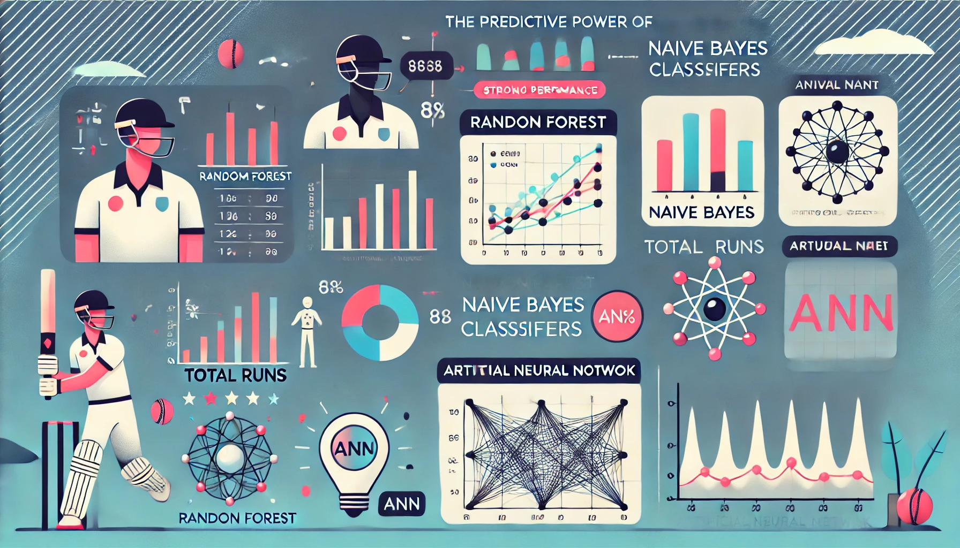
Conclusion
The study demonstrated the predictive power of machine learning models in cricket. Random Forest and Naive Bayes classifiers showed strong performance in predicting total runs, while ANN effectively predicted the likelihood of a wicket falling.

